Slide 1
Status of CEPC xxxxxxxx Readout Electronics

Slide 2
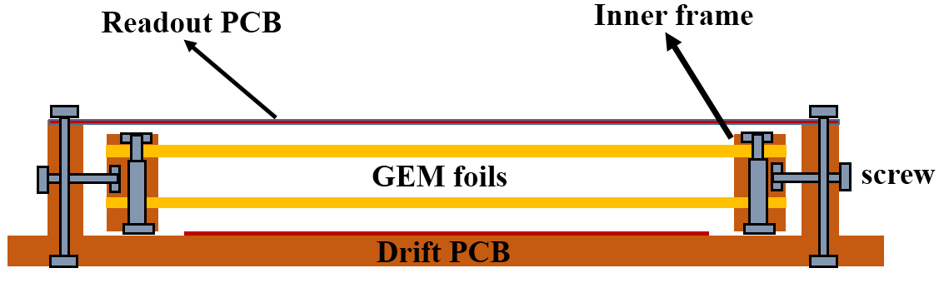
SDHCAL based on GEM
GEM with self-stretching techniques
Advantages：
1. Easy assembling
2. Uniform gas flow
3. Detachable
4. No dead area inside the active area
Detector and readout plane with 1cmx1cm size

Slide 3
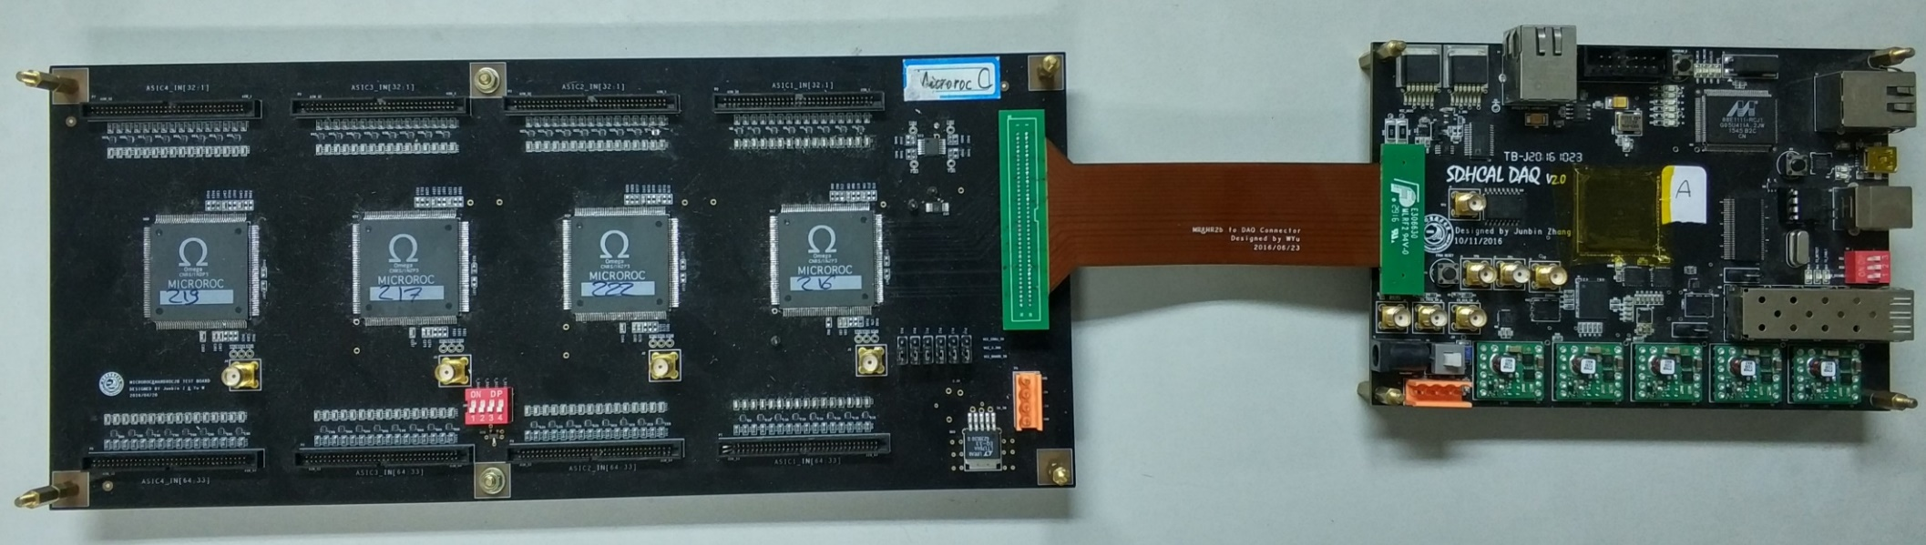
Readout Electronics Design
FEB with MICROROC
Single board with 256 channels
Connected via flexible plate
DIF
Multiple readout interfaces such as DTCC, SFP, Ethernet and USB

Slide 4
Cosmic-Ray Test
Use two PMT for coincidence detection

Slide 5
Cosmic-Ray Test
Scan the gain of detector to obtain the efficiency and multiplicity
Scan the threshold under thes
Detection efficiency and multiplicity vary with voltage
Detection efficiency and multiplicity vary with threshold

Slide 6
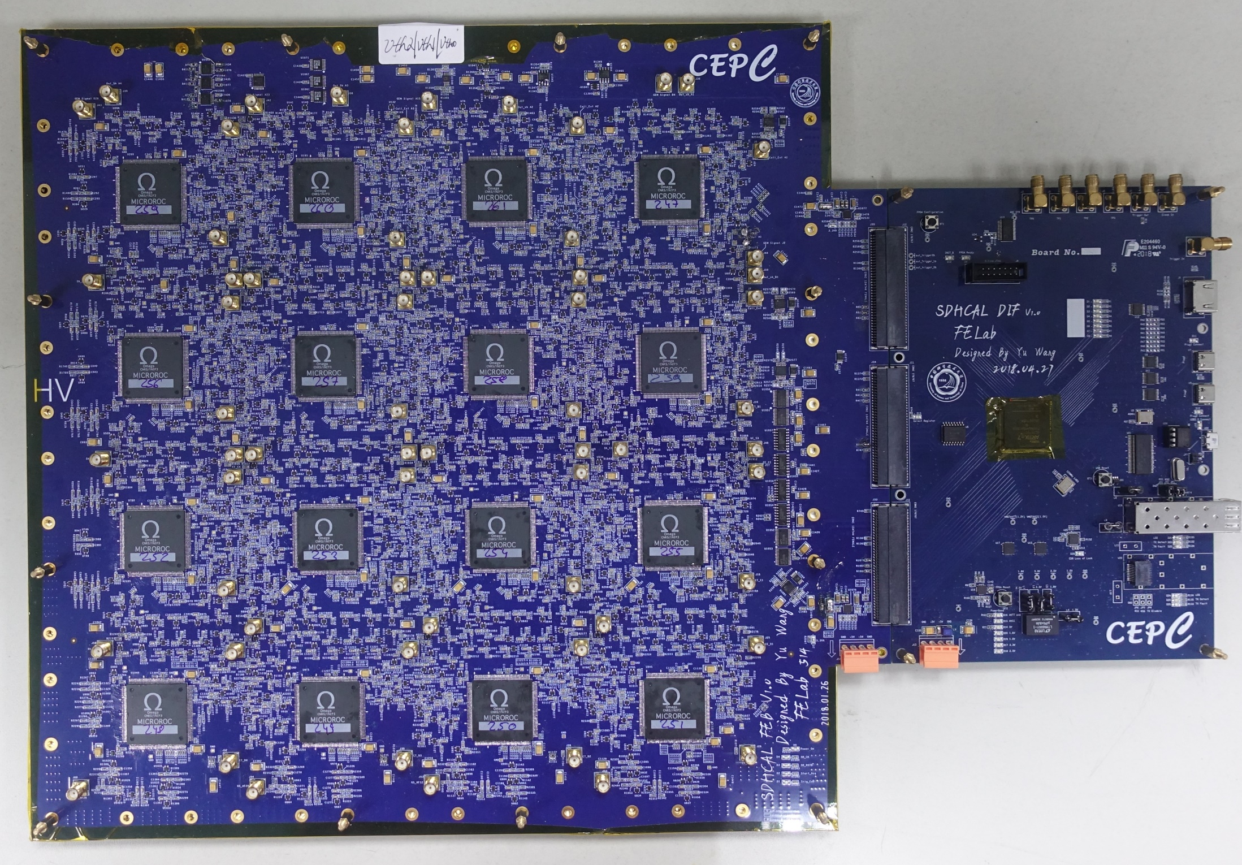
Next Step
A readout plane with embedded front-end electronics is designed
Blind buried via technique is used to ensure the signal integrity and gas tightness

Slide 7
Back Up

Slide 8
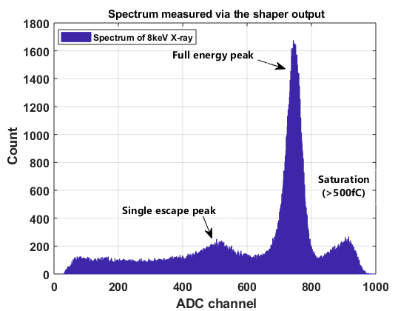
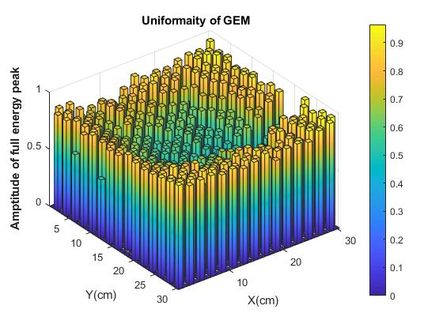
Laboratory Test
An external ADC is applied to measure the X-Ray energy spectrum
The detector gain uniform is obtained by the spectrum

